Slide 1
Exceptions & Testing Exceptions

Slide 2
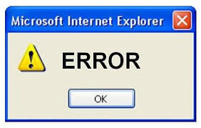
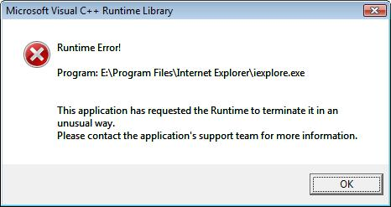
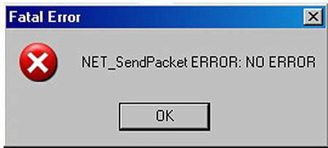
Any section of code can encounter or generate errors; there are different ways to deal with them
Terminate the program
only a reasonable choice for certain small programs
Return an "error" code from a function
this just pushes the problem up a level
Process or correct the error locally and go on
not always an option; local info often isn't enough
Call a function that services errors
difficult from a code-management point of view

Slide 3
Exception
An exception is an event, which occurs during the execution of a program, that disrupts the normal flow of the program's instructions.
Exception = Exceptional Event

Slide 4
Exception Handling
Java exception handling is a mechanism for handling exception by detecting and responding to exceptions in a systematic, uniform and reliable manner.

Slide 5
Exception Handling in Java
try
catch
throw
throws
finally
Keywords:

Slide 6
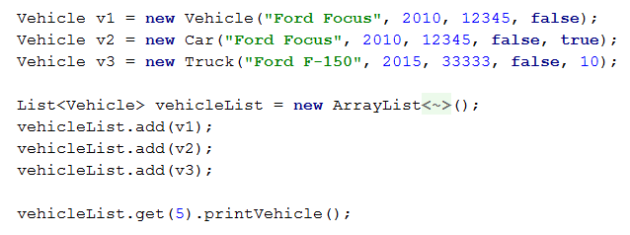
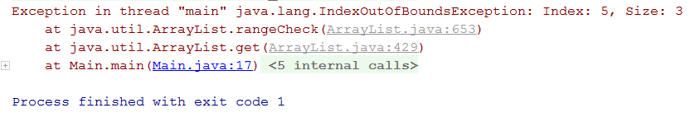
Example

Slide 7
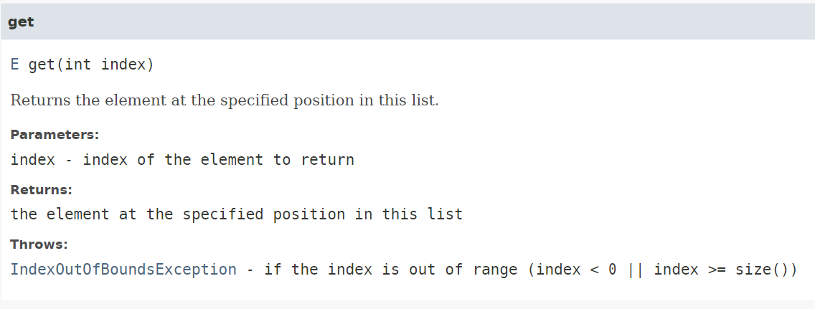
How does it know it is an IndexOutOfBoundsException Exception?
Let’s look at the documentation for ArrayList.get()
https://docs.oracle.com/javase/8/docs/api/java/util/List.html#get-int-

Slide 8
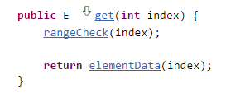
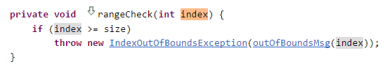

IndexOutOfBoundsException Exception
Let’s look at how ArrayList.get() is implemented

Slide 9
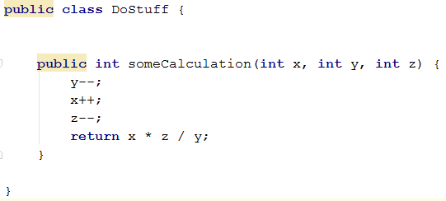


Exceptions Happen. Now What?
Need to handle exceptions

Slide 10
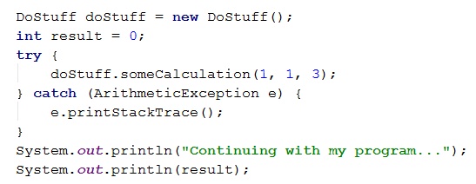
Handling Exceptions
Try Catch

Slide 11
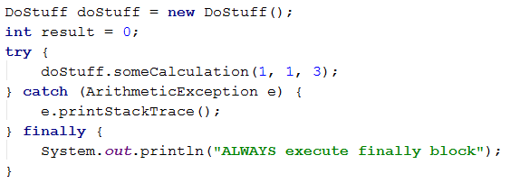
Handling Exceptions
Try Catch Finally
Use finally clause for code that must be executed "no matter what“
Executed even if there is a return statement prior to reaching the finally block

Slide 12
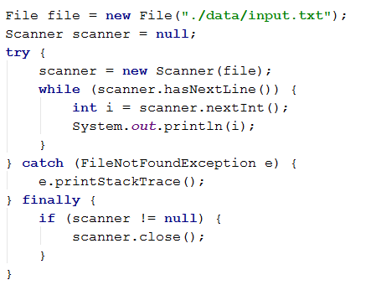
When should we use a finally block?
Whenever you have something to clean up
Release resource

Slide 13
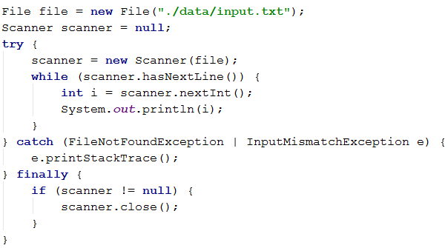
Catch Multiple Exceptions

Slide 14
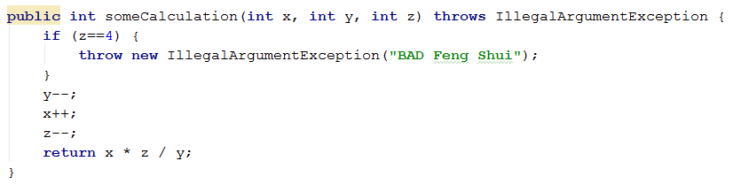
Last Piece… Throwing Exceptions
When somebody writes code that could encounter an exception,
it creates an object of appropriate Exception class and throws it
and must also declare it in case of checked exception

Slide 15
Throwing Exceptions... Wait a Minute
Why doesn’t ArrayList.get() declare throws in the method signature?
Only required to declare it in case of checked exception
IOException, FileNotFoundException, etc…

Slide 16
Java keywords for exception processing
throw – Generates an exception explicitly in our code. For example, in a user authentication program we may throw an exception to client if the password is null.
throws – Use the throws keyword in method signature to let the calling program know the exceptions that might be thrown by the method.
try-catch – try is the start of the block that may throw exceptions and catch is at the end of try block to handle the exceptions. One try block can have multiple catch ; try-catch blocks can be nested.
finally – The finally block is optional; it gets executed in all cases, whether an exception occurred or not.

Slide 17
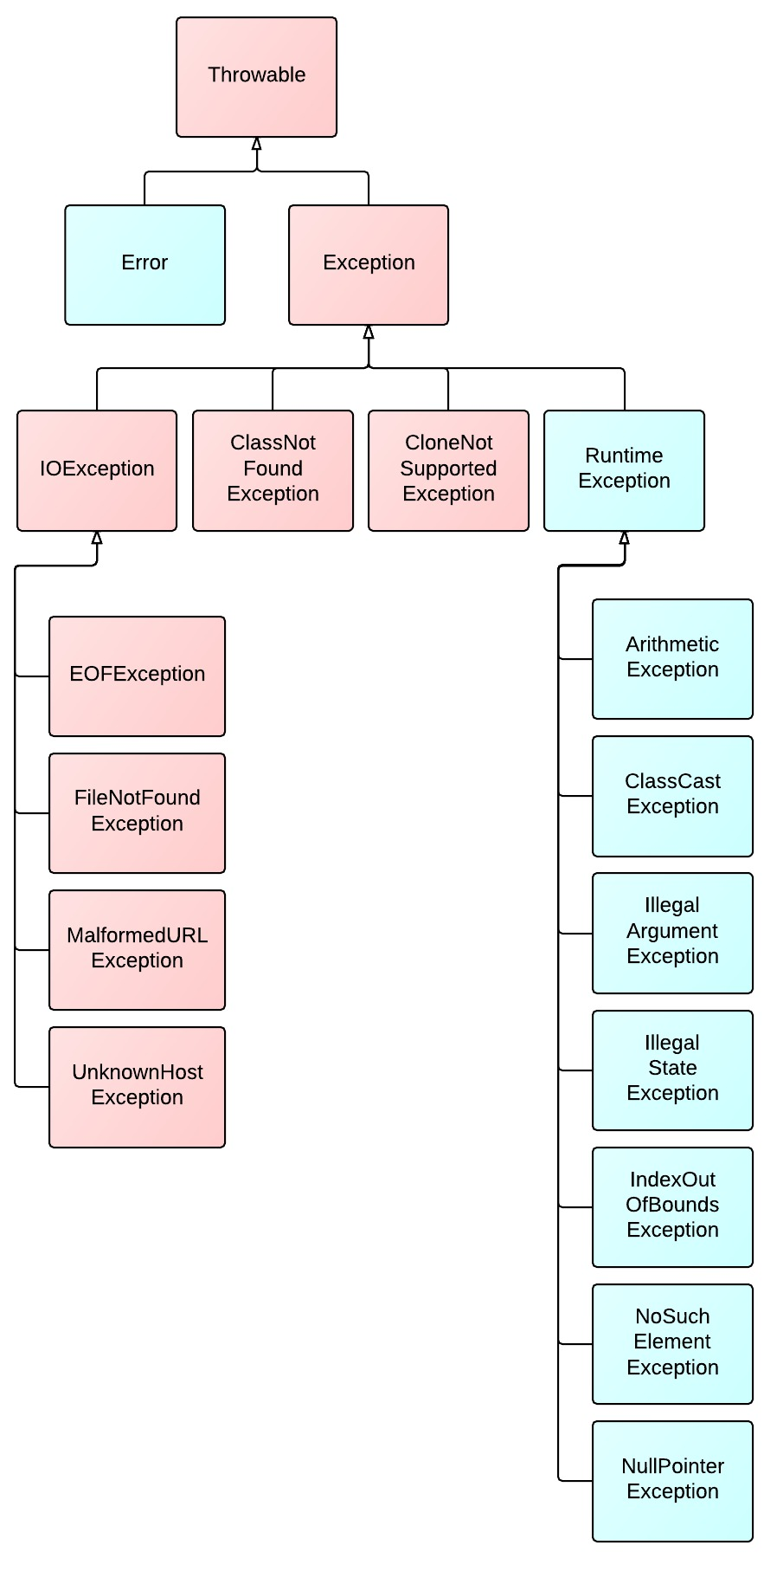
Exception Hierarchy
Red colored are checked exceptions.
Checked exceptions must be caught at compile time.
Blue colored are unchecked exceptions.
These exceptions are not expected to be recovered.
Errors are serious problems that a reasonable application should not try to catch
OutOfMemoryError, InternalError, ...

Slide 18
Creating Custom Exception Classes
Create custom exception classes if the predefined classes are not sufficient.
To declare custom exception class:
Create a class that extends Exception or a subclass of Exception.
It is good practice to add:
An argument-less constructor
Another constructor with one string type parameter
Another constructor with Throwable to support chained exceptions (shown later)

Slide 19
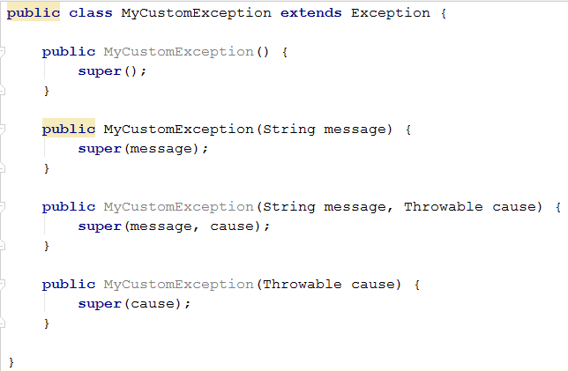
Custom Exception

Slide 20
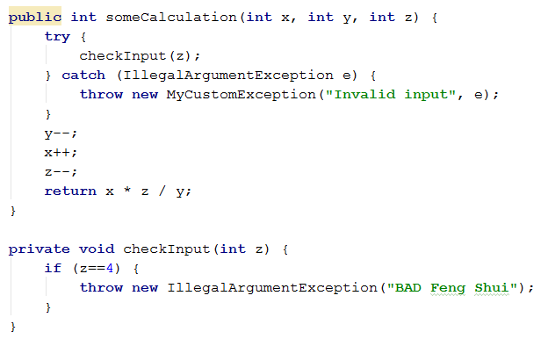
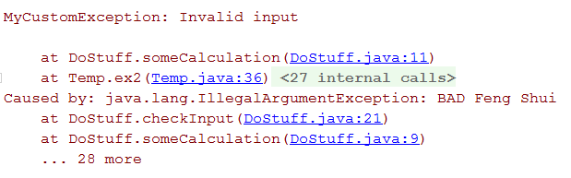
Example : Chained Exceptions Know when one exception causes another

Slide 21
Testing for exceptions
@Test(expected = ExceptionType.class)
public void name() {
...
}
Will pass if it does throw the given exception.
If the exception is not thrown, the test fails.
Use this to test for expected errors.
@Test(expected = ArrayIndexOutOfBoundsException.class)
public void testBadIndex() {
ArrayIntList list = new ArrayIntList();
list.get(4); // should fail
}

